Slide 1

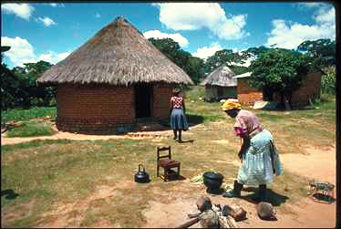

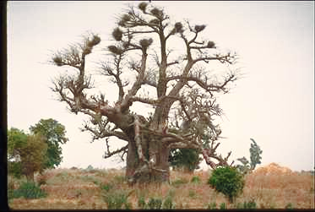
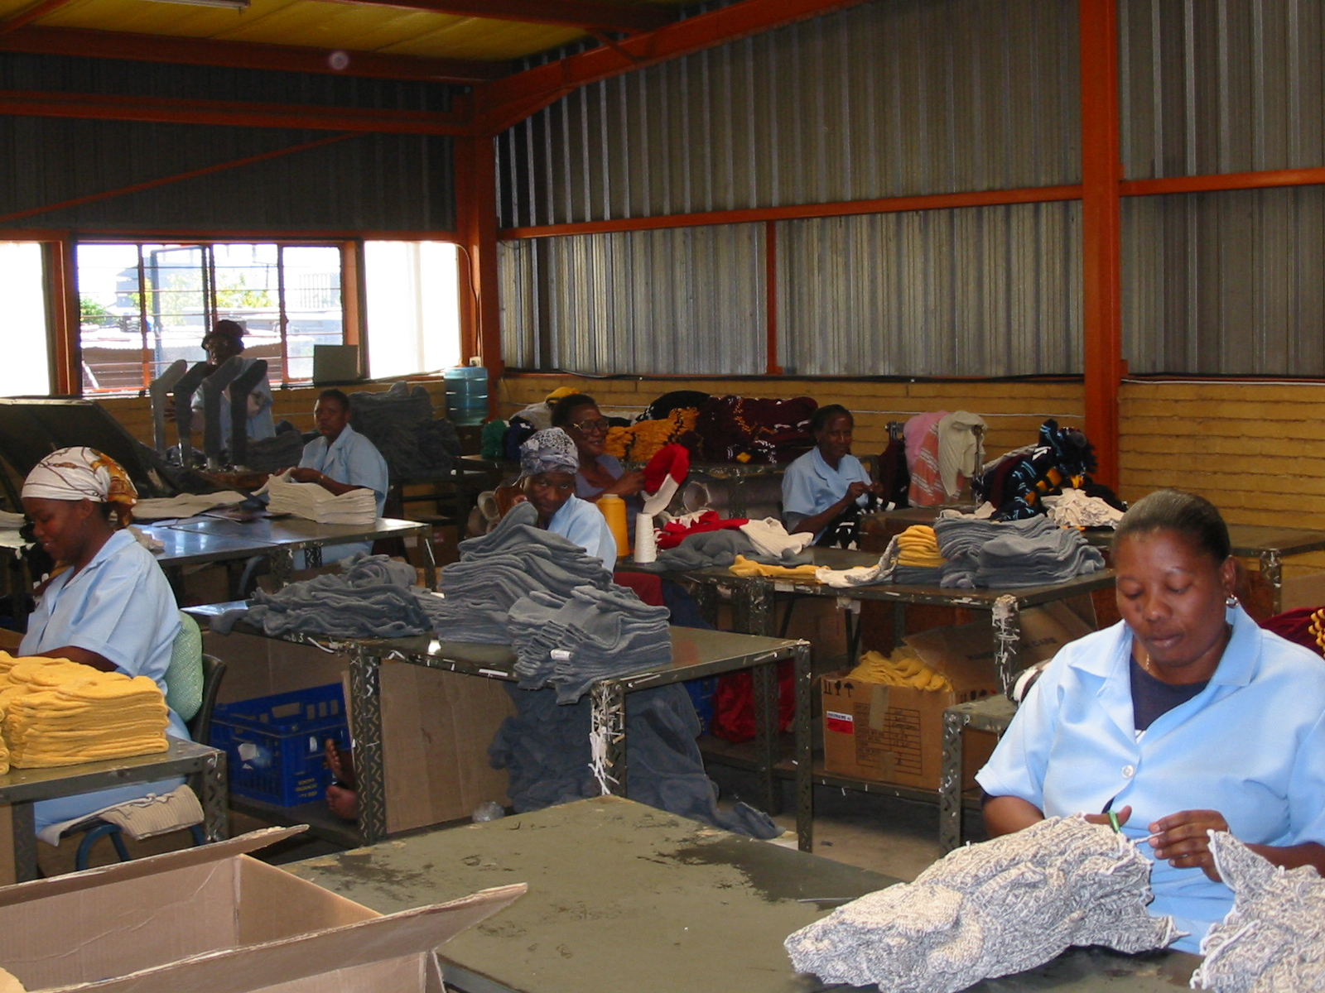

MAKHADO MUNICIPALITY
Local Economic Development Plan
DRAFT REPORT –JUNE 2005
Prepared for:
Prepared by:
Development Economists
Private Bag X2596
Makhado
0920
TEL: (015) 519 3000
FAX: (015) 516 1195/5084
P.O. Box 13554
Hatfield
0028
TEL: (012) 342 8686
FAX: (012) 342 8688
E-mail: pretoria@urban-econ.com

